Slide 1
Second Quarter 2024
Earnings Call Presentation
August 1st, 2024

Slide 2
Legal Disclaimer
This presentation includes “forward-looking statements.” Such forward-looking statements are subject to a number of risks and uncertainties, many of which are not under AR’s control. All statements, except for statements of historical fact, made in this presentation regarding activities, events or developments AR expects, believes or anticipates will or may occur in the future, such as those regarding our strategy, future operations, financial position, estimated revenues and losses, projected costs, prospects, plans and objectives of management, return of capital, expected results, future commodity prices, future production targets, realizing potential future fee rebates or reductions, including those related to certain levels of production, leverage targets and debt repayment, future earnings, future capital spending plans, improved and/or increasing capital efficiency, estimated realized natural gas, natural gas liquids and oil prices, expected drilling and development plans, projected well costs and cost savings initiatives, future financial position, future marketing opportunities, the participation level of our drilling partner and the financial and production results to be achieved as a result of the drilling partnership and the key assumptions underlying its projection and AR’s environmental goals are forward-looking statements within the meaning of Section 27A of the Securities Act of 1933 and Section 21E of the Securities Exchange Act of 1934. All forward-looking statements speak only as of the date of this presentation. Although AR believes that the plans, intentions and expectations reflected in or suggested by the forward-looking statements are reasonable, there is no assurance that these plans, intentions or expectations will be achieved. Therefore, actual outcomes and results could materially differ from what is expressed, implied or forecast in such statements. Except as required by law, AR expressly disclaims any obligation to and does not intend to publicly update or revise any forward-looking statements.
AR cautions you that these forward-looking statements are subject to all of the risks and uncertainties incident to the exploration for and the development, production, gathering and sale of natural gas, NGLs and oil, most of which are difficult to predict and many of which are beyond AR’s control. These risks include, but are not limited to, commodity price volatility, inflation, supply chain disruption, lack of availability of drilling, completion and production equipment and services, environmental risks, drilling and completion and other operating risks, marketing and transportation risks, regulatory changes and changes in law, the uncertainty inherent in estimating natural gas and oil reserves and in projecting future rates of production, cash flow and access to capital, the timing of development expenditures, impacts of geopolitical events and world health events, cybersecurity risks, conflicts of interest among our stockholders, the state of markets for and availability of verified carbon offsets and the other risks described under the heading "Item 1A. Risk Factors" in AR’s Annual Report on Form 10-K for the year ended December 31, 2023. Any forward-looking statement speaks only as of the date on which such statement is made and AR undertakes no obligation to correct or update any forward-looking statement whether as a result of new information, future events or otherwise, except as required by applicable law.
This presentation also includes AR non-GAAP measures which are financial measures that are not calculated in accordance with U.S. generally accepted accounting principles (“GAAP”). Please see “Antero Non-GAAP Measures” for definitions of these measures as well as certain additional information regarding these measures.
Antero Resources Corporation is denoted as “AR” in the presentation and Antero Midstream Corporation is denoted as “AM”, which are their respective New York Stock Exchange ticker symbols.
2

Slide 3
Drilling and Completion Efficiencies
Completed Avg. Lateral Lengths (Feet)
Spud to Kick Off Point (Days)
20% Reduction
33% Increase
Increased Completion Stages per Day…
Significantly Reduces Cycle Time per Pad ⁽¹⁾
49% Increase
28% Reduction
Note: Percentage increase or decrease arrows represent change from 2022 to 2Q 2024 or 1H 2024 where indicated.
Cycle time represents days from surface spud date to first production date, normalized for lateral length and intentionally deferred completions.
3

Slide 4
Antero Wells Continue to Outperform Peers
Antero leads its Appalachian peers in well productivity trends, and importantly, continues to increase its liquids productivity
AR Cumulative Well Productivity vs. Peers
(MMcfe/1,000’)
Operator | Well Count | Lateral Length (ft)
 | 323 | 12,721
Peer Average ⁽¹⁾ | 903 | 12,449
Since
2020
+24% vs
peer avg
Peer Average ⁽¹⁾
Source: Wellhead production from Enverus public data. Well BTU categorization based on Antero internal BTU mapping data. Processing shrink and NGL yields consistently assigned across all operators based on assigned BTU buckets.
Note: Production data cutoff at 24 months. Peers limited to SW Marcellus Operators with a minimum of 190 wells TIL since 2020. Represents cumulative sum of the average rate-time profile. Assumes no processing for wells with less than 1100 BTU (zero C3+ yield). Represents Enverus lateral lengths for peer average and internal lateral lengths for AR data.
Peers include EQT, RRC and SWN (SW Marcellus wells).
4
Notes:
Updated 10/24/2022 - RH

Slide 5
Antero Capital Efficiency vs. Peers
Capital Efficiency Drivers
Capital Efficiency
(2024E D&C Capital/ 2024E Production)
Operational Efficiencies via Enhanced D&C Techniques
Strong Well Performance
Longer Laterals > 11% Y-O-Y Increase
Efficient D&C Program 2 Rigs / 1.2 Completion Crews
~26% Y-O-Y Reduction in D&C Capital
Peer Average: $0.95
Note: Peers include CHK, CNX, EQT, RRC and SWN. Represents 2024 capital and production guidance updated for 2Q 2024 actuals. SWN represents consensus estimates as of 07/30/2024.
5
Notes:
Updated 10/24/2022 - RH

Slide 6
New U.S. Propane Export Records Set In Q2 2024
U.S. Exports of Propane/Propylene, Quarterly Average
(MMBbls/d)
2021
2022
2023
2024
Weekly Record High Set on April 19, 2024 of 2.34 MMBbl/d
Source: EIA, S&P Global Commodity Insights
6
Notes:
Updated 10/24/2022 - RH

Slide 7
Antero Holds Northeast LPG Export Advantage
AR’s export capacity is not impacted by near-term U.S. Gulf Coast capacity constraints
U.S. Gulf Coast LPG Export Capacity vs. LPG Exports
(MMBbls/d)
Existing Export Capacity
Export Capacity Additions
Near-term capacity constraints
LPG Exports (Actuals)
LPG Exports (Forecast)
Source: LPG Exports and forecast per IHS.
7
Notes:
Updated 10/24/2022 - RH

Slide 8
Improving U.S. LPG Export Fundamentals
Tight LPG Export Capacity Results in Premium Export Differentials
Export Premium vs. Mont Belvieu ⁽¹⁾
($/Gallon)
Source: S&P Global Commodity Insights.
Represents U.S. Gulf Coast Free on Board propane export differential to Mont Belvieu.
8

Slide 9
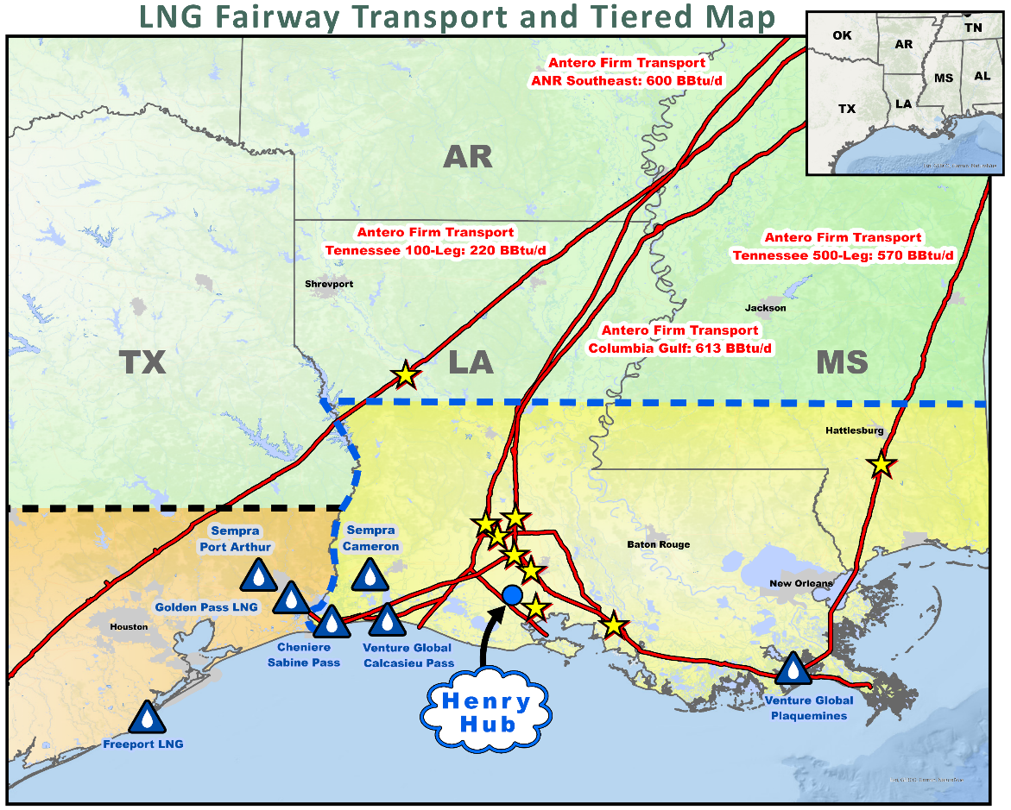
Not All Transport to the U.S. Gulf Coast is Equal
Henry Hub-Linked
(% of ‘24E Production)
“While everything 100 miles back of Henry Hub could be at $3-4/MMBtu regional cash price, Henry Hub cash could find itself at periods of time comfortably above $5/MMBtu.”
- JPM Commodities Research
Tier 3
Cal ’25: ($0.26)
Cal ’26: ($0.25)
Cal ‘27: ($0.28)
⁽¹⁾
Tier 1
TGP 500L
Cal ’25: $0.03
Cal ’26: $0.05
Cal ‘27: $0.04
Cal ’25: $0.36
Cal ’26: $0.55
Cal ‘27: $0.49
Tier 2
Cal ’25: ($0.24)
Cal ’26: ($0.21)
Cal ‘27: ($0.21)
TX
Antero Firm Transport Delivery Locations
Source: ICE data 2025-2027 strip pricing as of 07/29/2024.
Note: Tier boxes represent differentials to NYMEX Henry Hub.
1) Peers include CHK, CNX, EQT, RRC and SWN.
9

Slide 10
U.S. Power Burn
YTD 2024 average power burn is 1.4 Bcf/d higher than the prior year period
U.S. Natural Gas Demand From Power Burn (2013-YTD 2024)
(Bcf/d)
> 13 Bcf/d Total Increase 2013 - YTD 2024
Source: S&P Global Platts.
10
Notes:
Updated 3/19/2024 - RH

Slide 11
Lowest Free Cash Flow Breakeven
2024E Unhedged FCF Natural Gas Price Breakeven ⁽¹⁾
($/Mcf Henry Hub)
1H 2024 Unhedged Free Cash Flow / (Outspend) ⁽²⁾
($MM)
1H 2024 NYMEX Henry Hub: $2.07/MMBtu
Haynesville
Operators
Appalachian Operators
Antero
Source: Publicly disclosed guidance, company presentations, earnings call transcripts, Wall Street research. Peers include CHK, CNX, EQT, RRC and SWN.
2024 NGL and oil pricing reflects strip as of 07/25/2024.
Represents FCF after changes in working Capital. Free Cash Flow is a Non-GAAP metric. Please see appendix for additional disclosures.
11

Slide 12
AR Credit Momentum
Credit Ratings
(S&P Corporate Ratings)
5 Upgrades
Since 2020
($2.2) Bn
Debt reduction since 2019
Unsecured
Credit Facility
Investment Grade
Rating Achieved
BBB+
BBB
BBB-
BB+
BB
BB-
B+
B
B-
CCC+
CCC
CCC-
12

Slide 13
APPENDIX

Slide 14
Guidance
 | 2024 Guidance Ranges
Net Production (Bcfe/d) | 3.375 – 3.425
Net Natural Gas Production (Bcf/d) | 2.170 – 2.180
Net Liquids Production (Bbl/d) | 199,000 – 207,000
Net Daily C3+ NGL Production (Bbl/d) | 113,000 – 116,000
Net Daily Ethane Production (Bbl/d) | 76,000 – 80,000
Net Daily Oil Production (Bbl/d) | 10,000 – 11,000
Natural Gas Realized Price Expected Premium to NYMEX ($/Mcf) | $0.00 to $0.10
C2 Ethane Realized Price - Expected (Discount) / Premium to Mont Belvieu ($/Bbl) | ($1.00) - $1.00
C3+ NGL Realized Price - Expected Premium to Mont Belvieu ($/Bbl) ⁽¹⁾ | $1.00 - $2.00
Oil Realized Price Expected Differential to WTI ($/Bbl) | ($10.00) – ($14.00)
Cash Production Expense ($/Mcfe) ⁽²⁾ | $2.40 – $2.50
Net Marketing Expense ($/Mcfe) | $0.04 – $0.06
G&A Expense ($/Mcfe) (before equity-based compensation) | $0.12 – $0.14
D&C Capital Expenditures ($MM) | $650 - $700
Land Capital Expenditures ($MM) | $75 - $100
Average Operated Rigs, Average Completion Crews | Rigs: 2.0 | Completion Crews: 1.0 to 2.0 ⁽³⁾
Operated Wells Completed (Net) Operated Wells Drilled (Net) | Wells Drilled: 40 – 45 Wells Completed: 45 – 50
Average Lateral Lengths, Completed Average Lateral Lengths, Drilled | Drilled: 14,700 Completed: 15,500
Based on Antero C3+ NGL component barrel which consists of 57% C3 (propane), 9% isobutane (Ic4), 16% normal butane (Nc4) and 17% natural gasoline (C5+).
Includes lease operating expenses, gathering, compression, processing and transportation expenses (“GP&T”) and production and ad valorem taxes.
Expect to average 1.2 completions crews for the year.

Slide 15
Antero Resources Non-GAAP Measures
Adjusted EBITDAX: Adjusted EBITDAX as defined by the Company represents income or loss, including noncontrolling interests, before interest expense, interest income, unrealized gains or losses from commodity derivatives, but including net cash receipts or payments on derivative instruments included in derivative gains or losses other than proceeds from derivative monetizations, amortization of deferred revenue, VPP, income taxes, impairment of property and equipment, depletion, depreciation, amortization, and accretion, exploration expense, equity-based compensation expense, contract termination, loss contingency, transaction fees, gain or loss on sale of assets, loss on convertible note inducement, equity in earnings of and dividends from unconsolidated affiliates and Martica-related adjustments.
The GAAP financial measure nearest to Adjusted EBITDAX is net income or loss including noncontrolling interest that will be reported in Antero’s condensed consolidated financial statements. While there are limitations associated with the use of Adjusted EBITDAX described below, management believes that this measure is useful to an investor in evaluating the Company’s financial performance because it:
is widely used by investors in the oil and natural gas industry to measure operating performance without regard to items excluded from the calculation of such term, which may vary substantially from company to company depending upon accounting methods and the book value of assets, capital structure, and the method by which assets were acquired, among other factors;
helps investors to more meaningfully evaluate and compare the results of Antero’s operations from period to period by removing the effect of its capital and legal structure from its consolidated operating structure; and
is used by management for various purposes, including as a measure of Antero’s operating performance, in presentations to the Company’s board of directors, and as a basis for strategic planning and forecasting. Adjusted EBITDAX is also used by the board of directors as a performance measure in determining executive compensation.
There are significant limitations to using Adjusted EBITDAX as a measure of performance, including the inability to analyze the effects of certain recurring and non-recurring items that materially affect the Company’s net income or loss, the lack of comparability of results of operations of different companies, and the different methods of calculating Adjusted EBITDAX reported by different companies. In addition, Adjusted EBITDAX provides no information regarding a company’s capital structure, borrowings, interest costs, capital expenditures, and working capital movement or tax position.
Net Debt: Net Debt is calculated as total long-term debt less cash and cash equivalents. Management uses Net Debt to evaluate its financial position, including its ability to service its debt obligations.
Leverage: Leverage is calculated as Net Debt divided by LTM Adjusted EBITDAX.
Free Cash Flow: Free Cash Flow is a measure of financial performance not calculated under GAAP and should not be considered in isolation or as a substitute for cash flow from operating, investing, or financing activities, as an indicator of cash flow, or as a measure of liquidity. The Company defines Free Cash Flow as Net Cash Provided by Operating Activities, less Net Cash Used in Investing Activities, which includes drilling and completion capital and leasehold capital, plus payments for derivative monetizations, less proceeds from asset sales and less distributions to non-controlling interests in Martica.
Free Cash Flow is a useful indicator of the Company’s ability to internally fund its activities and to service or incur additional debt and estimate return of capital. There are significant limitations to using Free Cash Flow as a measure of performance, including the inability to analyze the effect of certain recurring and non-recurring items that materially affect the Company’s net income, the lack of comparability of results of operations of different companies and the different methods of calculating Free Cash Flow reported by different companies. Free Cash Flow does not represent funds available for discretionary use because those funds may be required for debt service, land acquisitions and lease renewals, other capital expenditures, working capital, income taxes, exploration expenses, and other commitments and obligations.
15

Slide 16
Antero Resources Adjusted EBITDAX Reconciliation
 |  | Three Months Ended June 30,
 |  | 2023 |  |  | 2024
Reconciliation of net loss to Adjusted EBITDAX:
Net loss and comprehensive loss attributable to Antero Resources Corporation |  | $ | (83,084) |  |  | (65,663)
Net income and comprehensive income attributable to noncontrolling interests |  |  | 15,151 |  |  | 5,208
Unrealized commodity derivative (gains) losses |  |  | (4,803) |  |  | 11,479
Amortization of deferred revenue, VPP |  |  | (7,618) |  |  | (6,739)
Gain on sale of assets |  |  | (220) |  |  | (18)
Interest expense, net |  |  | 27,928 |  |  | 32,681
Income tax benefit |  |  | (29,833) |  |  | (13,334)
Depletion, depreciation, amortization and accretion |  |  | 172,610 |  |  | 171,316
Impairment of property and equipment |  |  | 15,710 |  |  | 313
Exploration expense |  |  | 743 |  |  | 643
Equity-based compensation expense |  |  | 13,512 |  |  | 17,151
Equity in earnings of unconsolidated affiliate |  |  | (19,098) |  |  | (20,881)
Dividends from unconsolidated affiliate |  |  | 31,284 |  |  | 31,284
Contract termination, loss contingency, transaction expense and other |  |  | 4,444 |  |  | 3,020
 |  |  | 136,726 |  |  | 166,460
Martica related adjustments ⁽¹⁾ |  |  | (23,625) |  |  | (15,058)
Adjusted EBITDAX |  | $ | 113,101 |  |  | 151,402
Adjustments reflect noncontrolling interests in Martica not otherwise adjusted in amounts above.
16

Slide 17
Antero Resources Free Cash Flow Reconciliation
 | Six Months Ended June 30,
 | 2024
Net cash provided by operating activities |  | 405,109
Less: Net cash used in investing activities |  | (414,125)
Less: Proceeds from sale of assets, net |  | (418)
Less: Distributions to non-controlling interests in Martica |  | (42,899)
Free Cash Flow |  | (52,334)
Changes in Working Capital ⁽¹⁾ |  | (22,787)
Free Cash Flow before Changes in Working Capital |  | (75,120)
Working capital adjustments in the first six months of 2024 include ~$25 million in net increases in current assets and liabilities and less than ~$4 million in net increases in accounts payable and accrued liabilities for additions to property and equipment.
17

Slide 18
Antero Resources Total Debt to Net Debt Reconciliation
 |  | December 31, |  |  | June 30,
 |  | 2023 |  |  | 2024
Credit Facility |  | $ | 417,200 |  |  | 496,000
8.375% senior notes due 2026 |  |  | 96,870 |  |  | 96,870
7.625% senior notes due 2029 |  |  | 407,115 |  |  | 407,115
5.375% senior notes due 2030 |  |  | 600,000 |  |  | 600,000
4.250% convertible senior notes due 2026 |  |  | 26,386 |  |  | —
Unamortized debt issuance costs |  |  | (9,975) |  |  | (8,777)
Total long-term debt |  | $ | 1,537,596 |  |  | 1,591,208
Less: Cash and cash equivalents |  |  | — |  |  | —
Net Debt |  | $ | 1,537,596 |  |  | 1,591,208
18

