Slide 1
Internal Networking
Getting Smart About Your Company
Mark Chekanow, CFA
Director of Investor Relations
SWM International

Slide 2

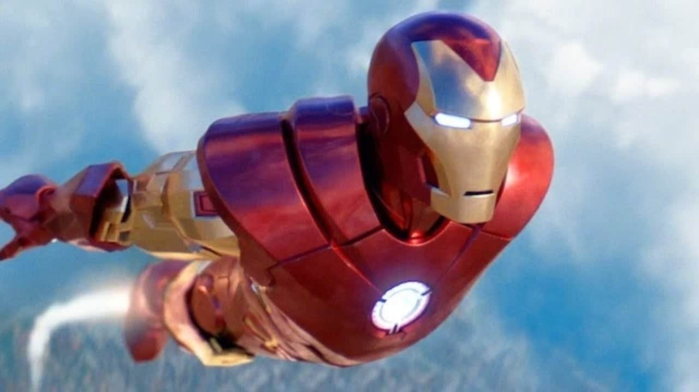
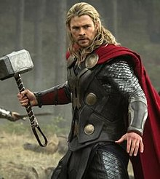






IR Draws On All Your Company’s Assets

Slide 3

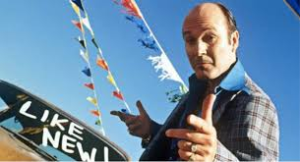

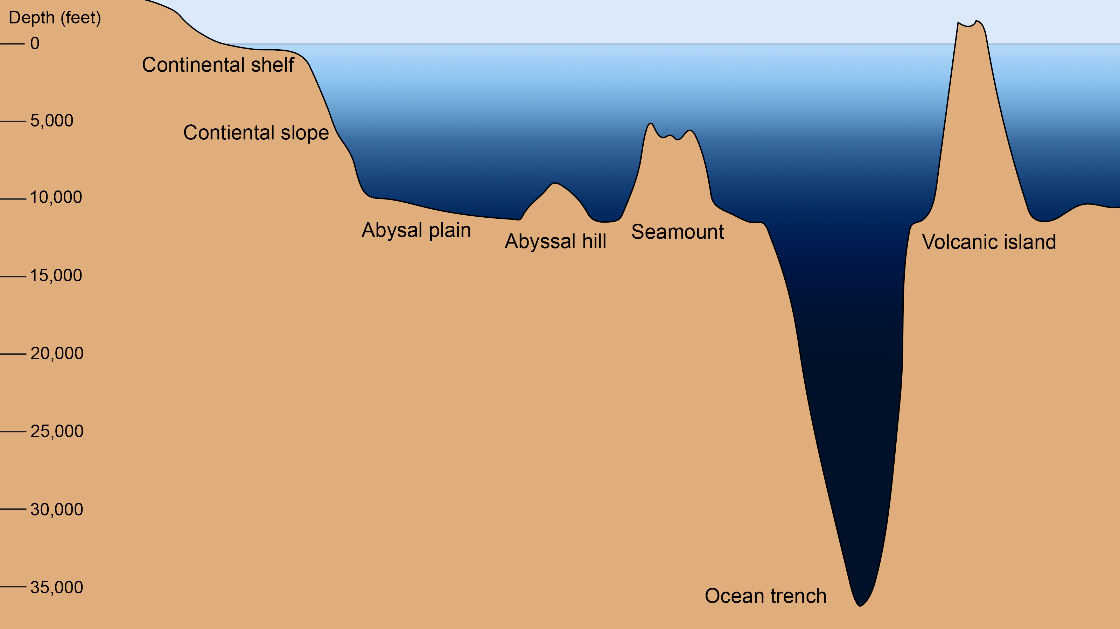
Your Role as an Expert
Educate (and promote)
Be well-versed and always prepared
Understand your audience –
high level with ability to go deep
BUT HOW?????
Fine line
Strategy & Vision
Financials
Outlook
End-Markets
Products / Services
Tax

Slide 4
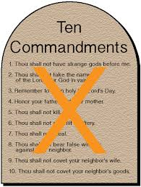
Core Values
Establish relationships
2 way street – help out
Listen
Give context
Get in the weeds
Be curious
Bring the investor perspective
Translate and distill
Have an inventory of stories/examples
Don’t be afraid to say “I don’t understand”

Slide 5
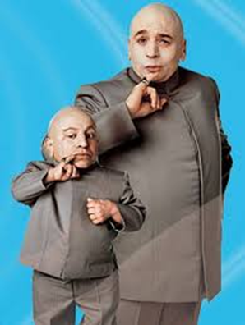
Strategy & Vision
Your “source”: CEO, executive team
Goal: Investor should feel like they are talking to the CEO, with an articulate message about the opportunities and direction of the business

Slide 6
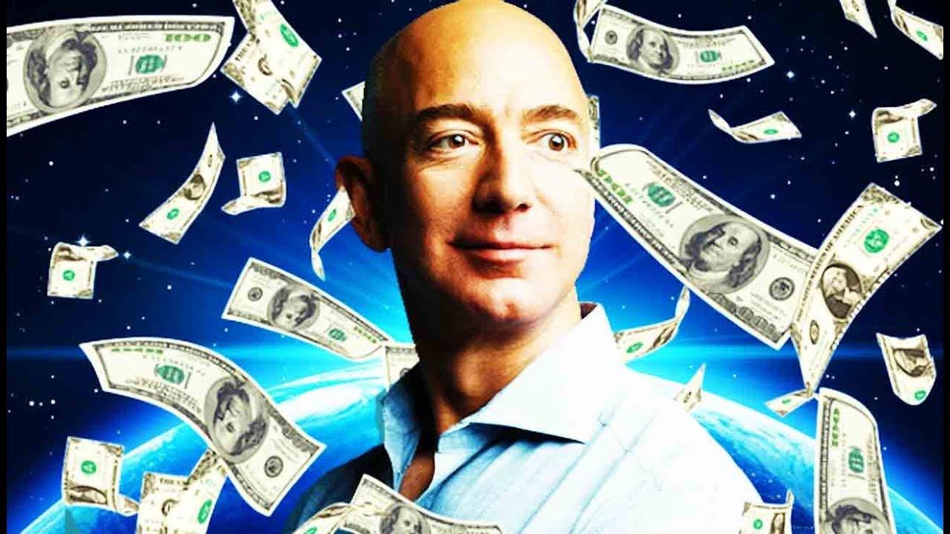
Financials
Your “source”: CFO, FP&A, controller, SEC reporting, ops/fin leads, all public info
Goal: Need to be able to simplify complex information into concise explanations and key takeaways… from technical accounting issues to margin variances to high-level trends

Slide 7
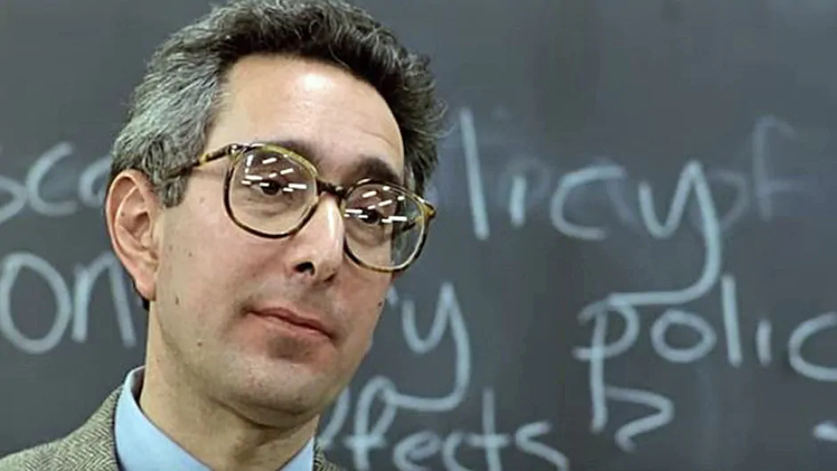
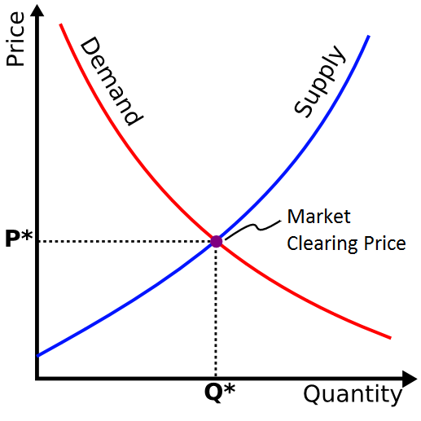
End-Markets
Your “source”: commercial leaders and salesforce
Goal: You should be able to explain the key drivers of your markets, customers, and competition…with detailed anecdotes and examples to bring it to life
Competition? Anyone? Pricing Power? Anyone?

Slide 8
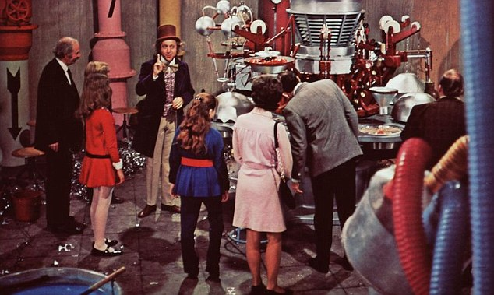
Products / Services
Your “source”: commercial leads, plant managers, engineers, developers
Goal: Be able to explain your products, how they work, your competitive advantages… make your investors feel like they truly understand what you provide

Slide 9
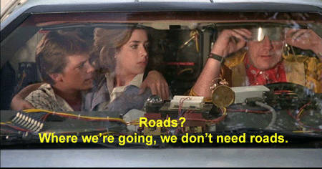
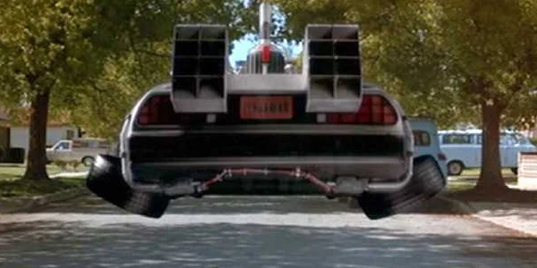
Outlook
Bring ALL YOUR SOURCES together
Goal: Get an investor excited about where your business is headed and how you will get there

Slide 10
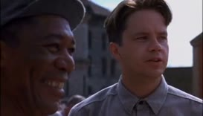
Some Things I Do (Beyond “The Usual”)
Produce Monthly BoD package, 1:1 monthly calls with business leaders
Visit sites when possible… meet operators, salesforce, etc.
Make myself a go-to for my CFO for ad-hoc requests or projects, always a chance to learn
Get involved in M&A diligence, integration
Help co-workers with management/BoD presentation
Educate co-workers on investor perspective on all their “output”… context!
Andy: “I understand you’re a man who knows how to get things.”
Red: “I’ve been known to locate certain things from time to time.”

Slide 11
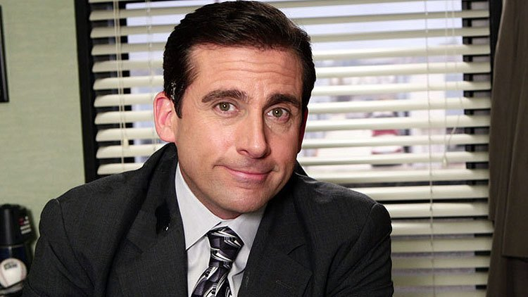
Q&A (hopefully there’s already been a lot)
Is Investor Relations the most important job at the company? Of course!
Is it anybody’s job to make sure they are provided everything they need? Absolutely not! ☺

